Slide 1
Snackability 1.0
Team Members: Bertha M Perez
Frank Hernandez Product Owner: Dr. Cristina Palacios
Instructor: Masoud Sadjadi School of Computing and Information Sciences Florida International University
Final Presentation
Spring 2018
Notes:
7 seconds.( I will select 2 best slides (i will give them extra points and students will present for CIS committee)
Greet your audience, thank them for attending your presentation, introduce yourself, introduce your project, introduce your team members, and quickly indicate what each of you did in a high-level manner, and put more emphasis on your part/contribution.

Slide 2
Project definition: Problem
Snacks consumed by adolescent and college students are extremely unhealthy.
USDA guidelines for healthy snacking not being applied.
There are no applications available that define healthy snacks in accordance with current snack guidelines published by the USDA.
Notes:
10 seconds.
Introduce the problem that the whole project (in all versions) tackles with GIF or screenshot.

Slide 3
Project definition: Solution
A mobile application to allow users to search for snacks and easily know how healthy the snack they’re searching for is.
A web API backed by a significant data source and a curated local database containing all snacks provided on FIU campuses.
A robust 1.0 application that has SOR and a DRY structure
Notes:
20 seconds.
Introduce the problem that the your project (in new version) tackles with GIF or screenshot.

Slide 4
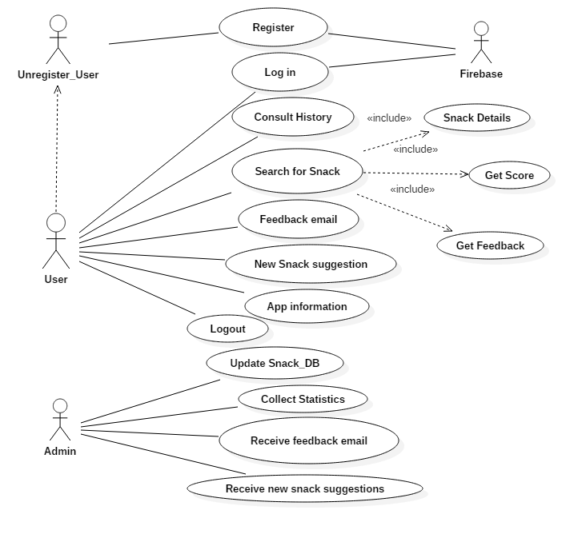
Requirements: Use Cases
Notes:
5 seconds
Show the Use Case Diagram for the whole project. Highlight your use cases.

Slide 5
Requirements: Use Cases
Notes:
5 seconds
Show the Use Case Diagram for the whole project. Highlight your use cases.

Slide 6
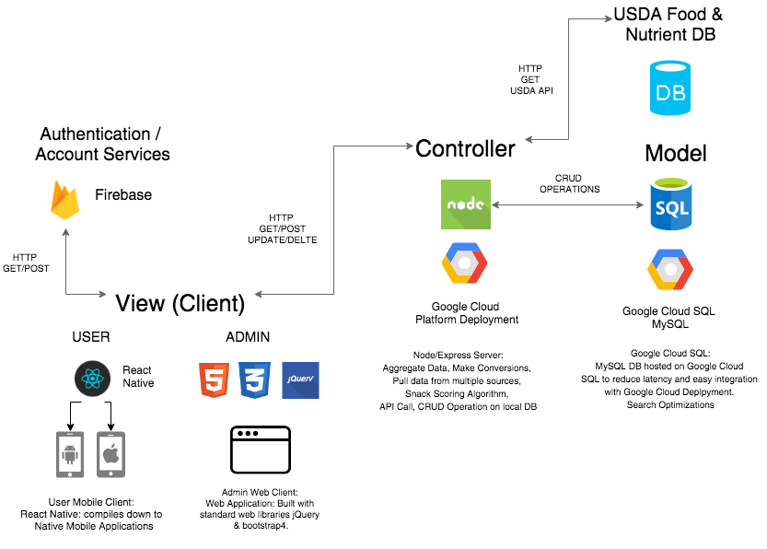
System Design: Architecture
Notes:
20 seconds
System design: Highlight the parts that you contributed to them.
1. System decomposition; identify the architecture patterns used
2. System deployment – h/w and s/w requirements

Slide 7
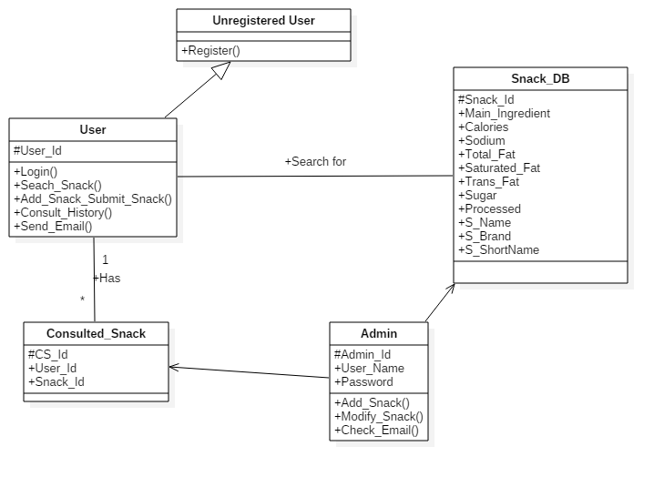
Minimal Class Diagram
Notes:
10 seconds.Minimal class diagram. Highlight the classes that you created/modified
Identify the design patterns used (one or more slides).

Slide 8
User Stories
1. User Story 669: User Registration
2. User Story 670: User login persistence
3. User Story 671: USDA Endpoint
4. User Story 672: Add new snacks to the Local Database
5. User Story 677: Temporary Server Testing Space
6. User Story 678: Create a Basic Mock-Up
7. User Story 679: Measurement Conversion
8. User Story 680: Snack Score
9. User Story 681: Access the local database
Notes:
5 seconds.
List the user stories that you worked on them.(put in order of importance). Stay focused on the parts that you have been working.

Slide 9
User Stories
10. User Story 683: Implementation of the local database
11. User Story 684 Gamification
12. User Story 685 FeedBack email
13. User Story 686: Receive FeedBack
14. User Story 687: General Information
15. User Story 688: Receive email about new Snack
16. User Story 689: New Snack Form
17. User Story 690: Consult History
18. User Story 691: Log out
Notes:
5 seconds.
List the user stories that you worked on them.(put in order of importance). Stay focused on the parts that you have been working.

Slide 10
User Registration
Description: As an Unregistered User I would like to sign up the app with my Gmail account or local account so that I don’t have to create a profile instead the application get that information for me
Acceptance Criteria:
Android screen with sign up using Gmail or local account buttons
Account opens appropriate authentication provider and then goes back to the application
Entry Condition:Unregistered user just downloaded the Snackability app
Exit Condition: Unregistered user become a user
Notes:
60 seconds
The tile of user story
The most important user story you worked on it. You have to describe this one very well and be proud of that.
Please present and show the complexity of your work, code, algorithms, and technical challenges and technologies you have used. (you could use screenshot if you want. Visual presentations are better than text presentation)
Go into the details of the most important/significant tasks using bullet lists or visual graphs or state chart diagram
Sequence Diagram for this user story is mandatory (in another separate page if required)
Demo using screenshots or GIF (in another separate page if required)

Slide 11
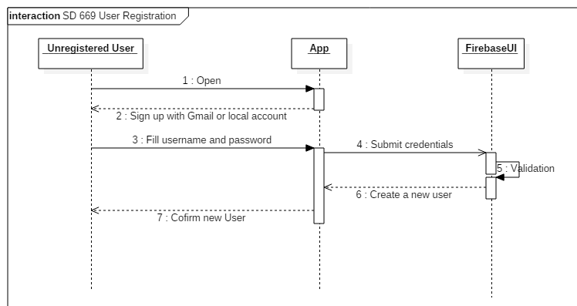
User Registration
Notes:
60 seconds
The tile of user story
The most important user story you worked on it. You have to describe this one very well and be proud of that.
Please present and show the complexity of your work, code, algorithms, and technical challenges and technologies you have used. (you could use screenshot if you want. Visual presentations are better than text presentation)
Go into the details of the most important/significant tasks using bullet lists or visual graphs or state chart diagram
Sequence Diagram for this user story is mandatory (in another separate page if required)
Demo using screenshots or GIF (in another separate page if required)

Slide 12
User login persistence
Description: As a User, I would like to authenticate on the mobile app just once so the application should save my credentials (unless I logged out last time)
Acceptance Criteria:
Be able to open the app without having to sign in
Entry Condition: User already signed in
Exit Condition: User log in automatically without input credentials
Notes:
20 seconds
The tile of user story
Please present and show the complexity of your work, code, algorithms, and technical challenges and technologies you have used. (you could use screenshot if you want. Visual presentations are better than text presentation) - Go into the details of the most important/significant tasks using bullet lists or visual graphs or state chart diagram - Demo using screenshots or GIF (in another separate page if required)
Sequence Diagram for this user story is optional

Slide 13
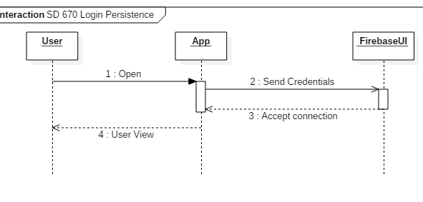
User login persistence
Notes:
20 seconds
The tile of user story
Please present and show the complexity of your work, code, algorithms, and technical challenges and technologies you have used. (you could use screenshot if you want. Visual presentations are better than text presentation) - Go into the details of the most important/significant tasks using bullet lists or visual graphs or state chart diagram - Demo using screenshots or GIF (in another separate page if required)
Sequence Diagram for this user story is optional

Slide 14
USDA Endpoint
Description: As an Administrator, I would like to see what kind of information I can get and send to the USDA API.
Acceptance Criteria:
Postman script targeting multiple USDA endpoints
A visual display of the JSON.
Related Tasks:
Get API for USDA database
The Product Owner Dr. Cristina Palacios request an API key for the project: 5iTjOxsZPmUo2U4p5SBQi1LL603l6x5b0jYsc4sO
Notes:
20 seconds
The tile of user story
Please present and show the complexity of your work, code, algorithms, and technical challenges and technologies you have used. (you could use screenshot if you want. Visual presentations are better than text presentation) - Go into the details of the most important/significant tasks using bullet lists or visual graphs or state chart diagram - Demo using screenshots or GIF (in another separate page if required)
Sequence Diagram for this user story is optional

Slide 15
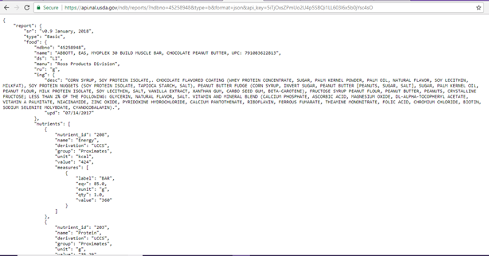
USDA Endpoint
The USDA API provides two kinds of reports: Food Reports which list nutrient values for a specified food and Nutrient Reports which contain lists of foods and their nutrient values for a specified set of nutrients.
We can find a lot of information; we are going to list what is relevant for our app
List of ingredients (We are going to use the main ingredient listed as the first ingredient)
Nutrients:
Energy (kcal) Sodium, Na(mg) Total Lipid(fat) (g) Fatty acids, total saturated (g) Fatty acids, total trans (g) Sugars
Notes:
20 seconds
The tile of user story
Please present and show the complexity of your work, code, algorithms, and technical challenges and technologies you have used. (you could use screenshot if you want. Visual presentations are better than text presentation) - Go into the details of the most important/significant tasks using bullet lists or visual graphs or state chart diagram - Demo using screenshots or GIF (in another separate page if required)
Sequence Diagram for this user story is optional

Slide 16
Add new snacks to the Local Database
Description: As an Admin I would like to be able to add snacks on campus to the database so that the database would be updated with all the products on campus
Acceptance Criteria:
Define Schema for the local database that will include nutrition values and score
Define test scripts
Entry Condition: Admin received an email reporting about a new item found on a vending machine that does not exist either in the local database or the USDA database
Exit Condition: New snack is added to the database
Notes:
20 seconds
The tile of user story
Please present and show the complexity of your work, code, algorithms, and technical challenges and technologies you have used. (you could use screenshot if you want. Visual presentations are better than text presentation) - Go into the details of the most important/significant tasks using bullet lists or visual graphs or state chart diagram - Demo using screenshots or GIF (in another separate page if required)
Sequence Diagram for this user story is optional

Slide 17
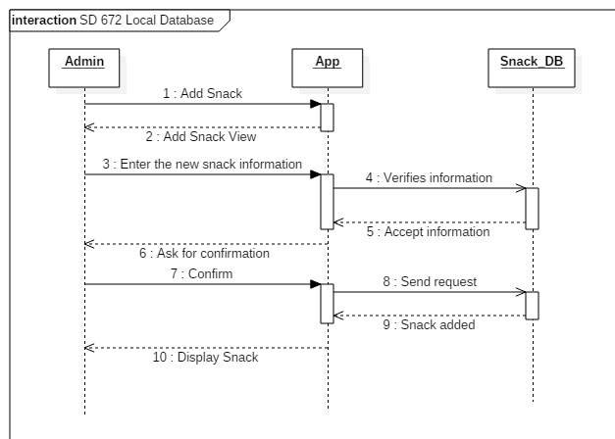
Add new snacks to the Local Database
Notes:
20 seconds
The tile of user story
Please present and show the complexity of your work, code, algorithms, and technical challenges and technologies you have used. (you could use screenshot if you want. Visual presentations are better than text presentation) - Go into the details of the most important/significant tasks using bullet lists or visual graphs or state chart diagram - Demo using screenshots or GIF (in another separate page if required)
Sequence Diagram for this user story is optional

Slide 18
Temporary Server Testing Space
Description: As an Administrator, I would like to be able to test the connection with the USDA Database a so I can retrieve information and test measurements conversion.
Acceptance Criteria:
Connect to USDA database
Retrieve information from USDA
Test differents measurements conversion
Notes:
20 seconds
The tile of user story
Please present and show the complexity of your work, code, algorithms, and technical challenges and technologies you have used. (you could use screenshot if you want. Visual presentations are better than text presentation) - Go into the details of the most important/significant tasks using bullet lists or visual graphs or state chart diagram - Demo using screenshots or GIF (in another separate page if required)
Sequence Diagram for this user story is optional

Slide 19
Temporary Server Testing Space
Notes:
20 seconds
The tile of user story
Please present and show the complexity of your work, code, algorithms, and technical challenges and technologies you have used. (you could use screenshot if you want. Visual presentations are better than text presentation) - Go into the details of the most important/significant tasks using bullet lists or visual graphs or state chart diagram - Demo using screenshots or GIF (in another separate page if required)
Sequence Diagram for this user story is optional

Slide 20
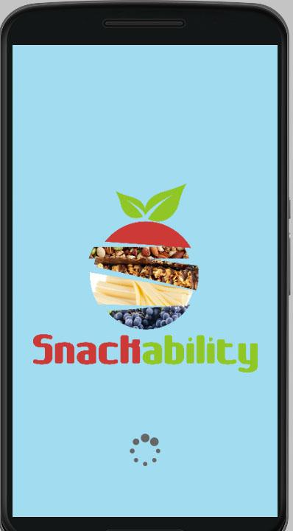
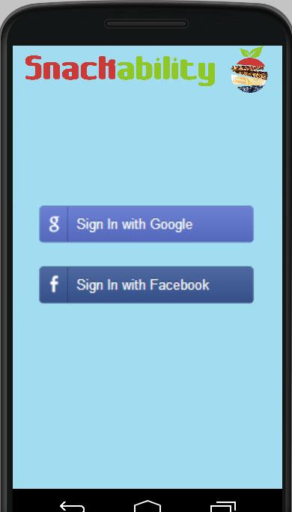
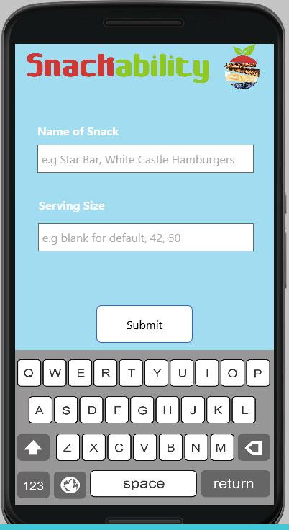
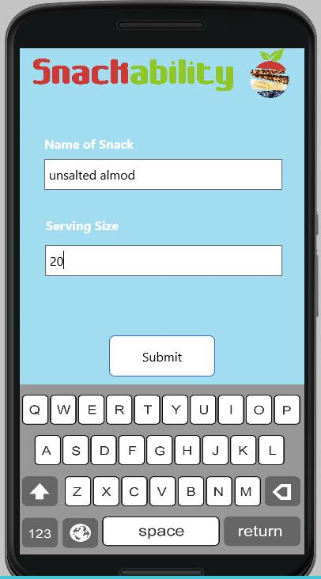
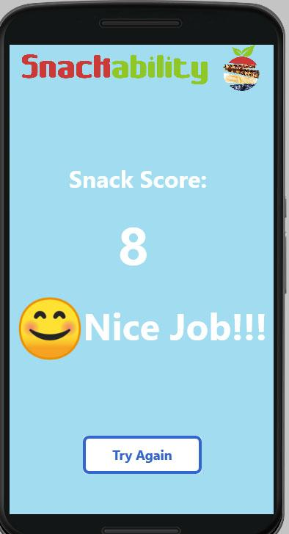
Create a Basic Mock-Up
Description: As an Admin I want to create a basic app Mock-Up so I can test the basic functionality of the app
Acceptance Criteria:
Create a friendly user interface

Slide 21
Measurement Conversion
Description: As a User, I would like to enter different food measurements so that the system should be able to deal with the conversion.
Acceptance Criteria:
User enters a snack with a measurement (cup, tbsp., gram, ounce)

Slide 22
Measurement Conversion
Cup | Millimeters | Tablespoon | Ounces | Grams
1/16 cup | 15 ml | 1 | ½ oz | 15 g
⅛ cup | 30 ml | 3 | 1 oz | 29 g
¼ cup | 59 ml | 4 | 2 oz | 57 g
⅓ cup | 79 ml | 5.5 | 2.5 oz | 72.5 g
⅜ cup | 90 ml | 6 | 3 oz | 85 g
½ cup | 118 ml | 8 | 4 oz | 113 g
⅔ cup | 158 ml | 11 | 5 oz | 141 g
¾ cup | 177 ml | 12 | 6 oz | 170 g
1 cup | 240 ml | 16 | 8 oz | 227 g
2 cup | 480 ml | 32 | 16 oz | 453 g

Slide 23
Snack Score
Description: As a User, I would like to get a snack score so that I know how healthy this snack is as per the USDA guidelines
Acceptance Criteria:
Enter a snack
Enter serving size
Select if the snack is processed or not
Note: As per meeting with the product owner, she has requested to ask the user if the snack is highly processed or not so we can obtain a more accurate score.

Slide 24
Snack Score
Principle | Score
1. Contain ≥50% whole grains by weight; 1st ingredient is a fruit, a vegetable, a dairy product, or a protein food; or combination of fruit and/or vegetable | 2
2. Nutrient standard for:
Calories ≤ 200 calories
1.0 – 50.0 Kcal 50.1 – 100.0 Kcal 100.1 – 150.0 Kcal 150.1 – 200.0 Kcal > 200.0 Kcal | 2 1.5 1 0.5 0
Total Fat ≤ 35% of calories
0 – 20.0% 20.1 – 35.0% >35.0% | 1 0.5 0
Saturated Fat <10% of calories
0 – 4.9% 5.0 - 9.9% 5.0 - 9.9% | 1 0.5 0
Trans Fat 0 g
Trans Fat 0 g Trans Fat > 0 g | 1 0

Slide 25
Access the local database
Description: As a User, I would like to be able to look for snacks located on the FIU vending machines so that I can get a score
Acceptance Criteria:
Be a registered user
Enter a Snack
Entry Condition: User must be log in; User want to search for a new snack
Exit Condition: User get a score and feedback for the snack entered

Slide 26
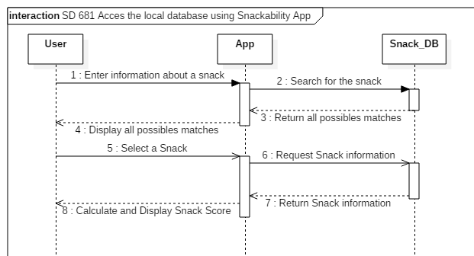
Access the local database

Slide 27
Implementation of the Local Database
Description: As an Admin I would like to have a database of all the snacks available at FIU’s vending machines
The product Owner Dr. Christina Palacios along with her students contacted the entity at FIU in charge of the vending machines, they sent them the list of all the snacks available, and they consult the manufacturer web page and the USDA database to collect all the items needed in order to calculate the food score so we can fill the local database for our app.

Slide 28
Gamification
Description:As a User, I would like to have a not only a score but general feedback on how healthy a snack is
Acceptance Criteria:
User enters a snack
The system calculates the score based on the measurement

Slide 29
Gamification
Score | Message
-2 😭 Loudly Crying Face | WARNING!! This snack is extremely low in nutrients! Do not consume!
-1 😨 Fearful Face | This snack is not healthy at all. Ditch this snack!
1-5 😩 Weary Face | This snack is not healthy, need to choose a healthier option.
6-7 😏 Smirking Face | This snack is somewhat healthy, but could be better.
8-9 🙂 Slightly smiling face | Good job! This snack is healthy!
10 😄 Grinning Face With Smiling Eyes | PERFECT score! This snack is very healthy!

Slide 30
FeedBack email
Description: As a User, I would like to be able to send feedback to the admin, so the administrator know how I feel about the app
Acceptance Criteria:
User wants to send feedback to the administrator.
Entry Condition:User must be log in
Exit Condition: User sends feedback to the administrator

Slide 31
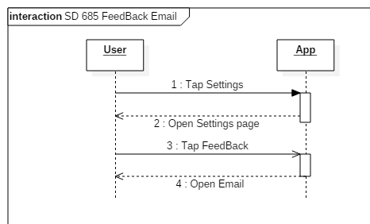
FeedBack email

Slide 32
Receive FeedBack
Description: As an Admin I would like to receive emails with feedbacks from users so I can take suggestions from them
Acceptance Criteria:
User sent an email reporting a new snack
Entry Condition:Admin must be log in
Exit Condition: Admin read emails

Slide 33
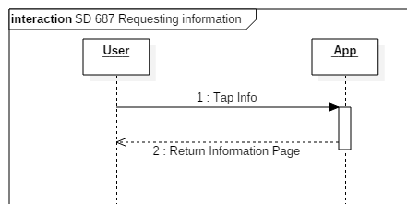
General Information
Description: As a User, I would like to know more about the Snackability application.
Entry Condition: User must be log in
Exit Condition: User see general information about Snackability app

Slide 34
Receive email about new Snack
Description: As an Admin I would like to receive forms from users about new snacks that were not found on the local database or the USDA database, so the Snackability app keeps updated.
Acceptance Criteria:
User sent an email reporting a new snack
Entry Condition: Admin must be log in
Exit Condition: Admin read emails

Slide 35
New Snack Form
Description: As a User, I would like to be able to fill a form to suggest new snacks to the admin, so the Snackability app keep updated
Acceptance Criteria:
User wants to recommend a new snack to the administrator.
Entry Condition: User must be log in
Exit Condition: User suggest a new snack to the administrator

Slide 36
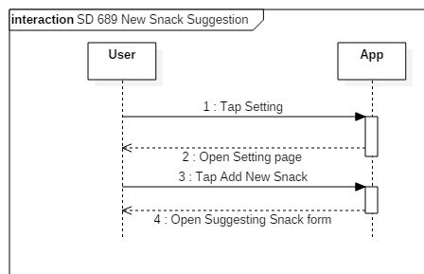
New Snack Form

Slide 37
Consult History
Description: As a User, I would like to know the snack I consulted before so I can keep learning on healthy snacking
Acceptance Criteria:
Have searched snacks before
Entry Condition: User must be log in
Exit Condition: User previous searched snacks

Slide 38
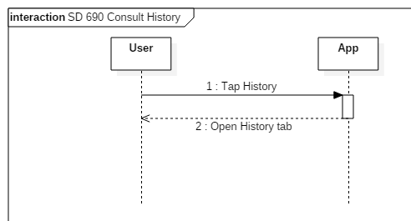
Consult History

Slide 39
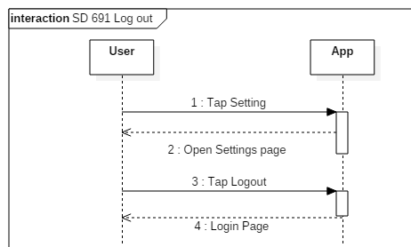
Log out
Description: As a User, I would like to be able to log out
Acceptance Criteria:
Have searched snacks before
Entry Condition: User must be log in
Exit Condition: User Log out

Slide 40
Test Suites and Test Cases
Postman tests were created to test various API endpoints.
Mocha+Chai, were used to create unit test for conversions and aggregations.
Application was tested on recent versions of Android and iOS emulators and on physical phones.
Manual checks done to verify accurate snack score and nutrient values.
Notes:
10 seconds
A description of verification process and Test Suites and Test Cases for one of the use cases.
1 One sunny day and one rainy day for the implemented use cases (one or more slides).
2 Automated test scripts for the implemented use cases (if any) (one or more slides).

Slide 41




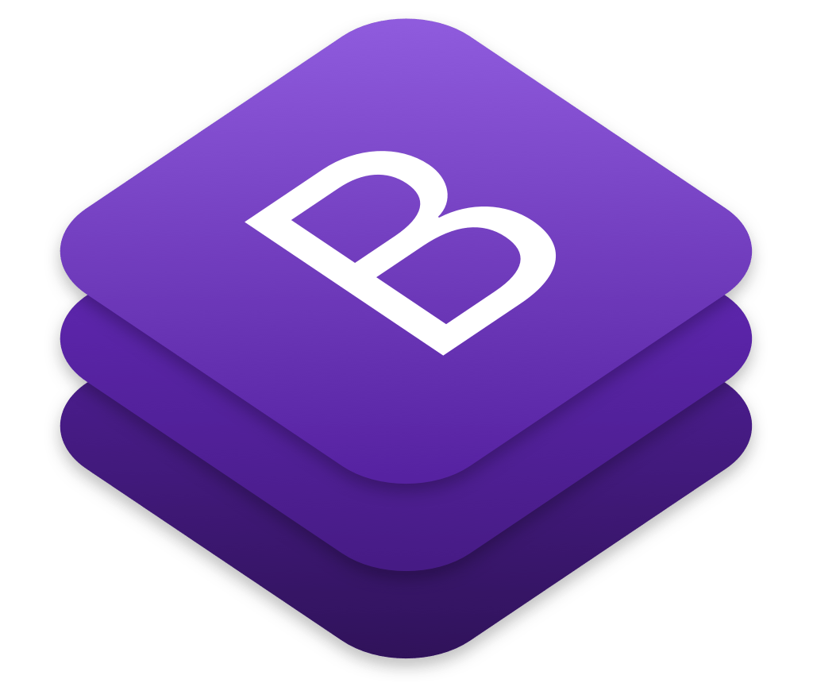





Summary
The objective of this project was to design an app that uses USDA guidelines to provide a numeric score based on a snack’s nutritional information. This project is the first release of Snackability app. The app is going to have an initial on-campus trial during conducted by the FIU Dietetics and Nutrition Department.
Bertha M Perez (bpere124@fiu.edu)
Frank Hernandez (fhern077@fiu.edu)
Questions?
Thank You!
Notes:
10 seconds
Summarize your contribution, mention your effort for Scrum, Mingle, Github, Google Drive Documentation and minutes
Include your contact information
Ask if anyone has any questions for you.
Thank your audience

